Slide 1
BZAN 554 · GROUP ASSIGNMENT 1
Incremental Learning
on Large Data
Feed-forward neural network predicting quantity sold
GROUP 7
Ansley · Rebecca · Ximin
Notes:
Group 7. Title slide carries the group ID as required; the filename does too.
One-line framing: we trained a 3-hidden-layer sigmoid network on 500,000 records using mini-batch incremental updates, never holding the model's training state for more than 32 records at a time.

Slide 2
Assignment Requirements
Every required deliverable and where to find it
Required deliverable | Slide | Status
R² on training and test sets | 7 | Done
Learning curve — moving-average MSE | 8 | Done
Variable importance plot | 9 | Done
Multiple partial dependence plots | 10–11 | Done
RAM usage | 12 | Done
Training time | 13 | Done
Statement of contributions | 14 | Done
Group ID on slide 1 + filename | 1 | Done
Notes:
Index slide so the grader can confirm completeness immediately.
All eight required elements are present. Partial dependence spans two slides: the plots themselves, then how to read them.

Slide 3
The Data
pricing.csv — one row = one product selling period
500,000
5
19 MB
0
records
input features
file size
missing values
Variable | Role | Range
sku | input — product ID | 0 – 74,998
price | input | 0 – 275
order | input — nth in-stock spell | 0 – 446
duration | input — time on site | 1 – 31.9
category | input — 32 categories | 0 – 32
quantity | TARGET — units sold | 1 – 4,165
Why this is hard
Target is highly skewed
mean 22.8, max 4,165
80 / 20 split, seed 42
400,000 train rows
Scaler fit on train only
Notes:
Data is confidential; we report only aggregate statistics.
The skew matters: mean quantity is 22.8 but the max is 4,165, and the median is 7. That long right tail is what makes squared error large in absolute terms and is why MSE values in the thousands are normal here rather than a sign of failure.
Split is 80/20 with seed 42. The scaler is fit on training rows only and applied to test — no leakage.

Slide 4
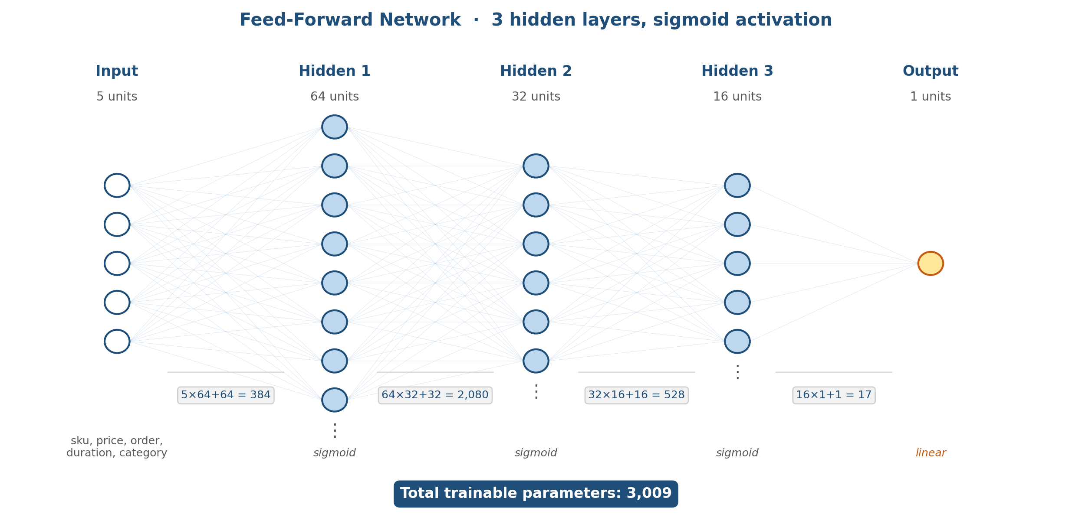
Network Architecture
REQUIRED
3 hidden layers · sigmoid · as specified
Notes:
Exactly what the assignment specifies: three hidden layers, sigmoid activation.
64 / 32 / 16 is a tapering funnel — each layer compresses the representation.
Parameter count, derivable by hand for the exam: (5x64+64)=384, (64x32+32)=2,080, (32x16+16)=528, (16x1+1)=17. Total 3,009.
The OUTPUT layer is linear, not sigmoid. Sigmoid outputs are bounded to (0,1); quantity ranges to 4,165. A sigmoid output could never reach the target values. Only the three HIDDEN layers use sigmoid.

Slide 5
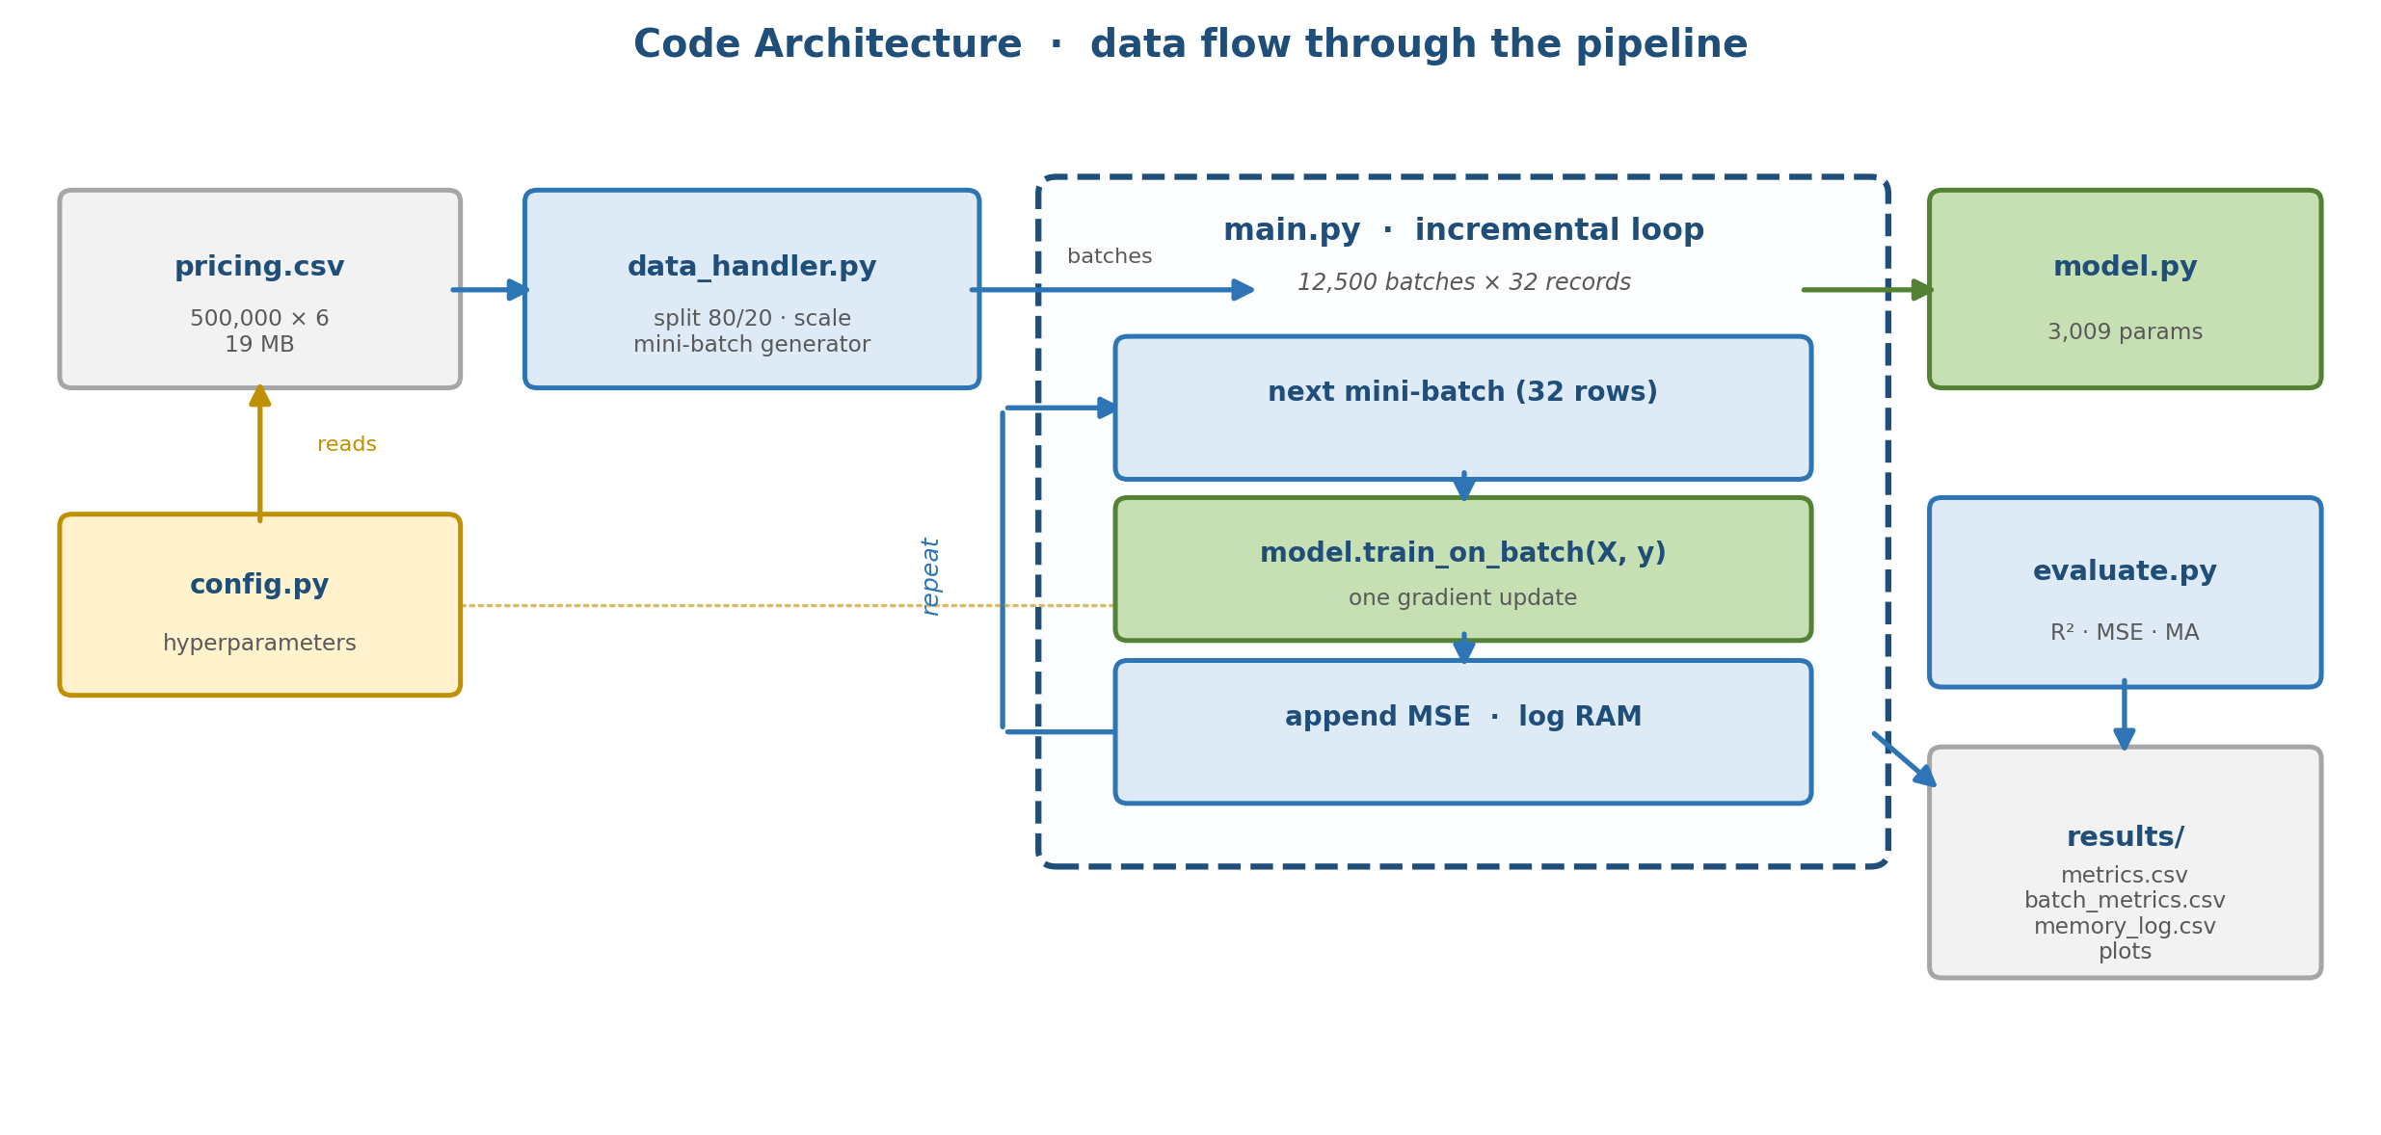
Code Architecture
Six modules, one responsibility each
Notes:
config.py holds every hyperparameter — nothing is hard-coded in the training loop, so any run is reproducible from one file.
data_handler.py splits, scales, and yields mini-batches through a generator.
main.py is the incremental loop: pull 32 rows, one gradient update, record MSE and RAM, repeat 12,500 times.
model.py builds the network; evaluate.py holds R2/MSE/moving-average; results/ collects all artifacts.

Slide 6
Incremental Training Loop
Read a mini-batch → update → repeat
for X_batch, y_batch in create_mini_batches(X_train, y_train):
metrics = model.train_on_batch(X_batch, y_batch)
mse_history.append(metrics[0])
memory_log.append(process.memory_info().rss / 1024**2)
32
12,500
1
records per update
weight updates
pass over data
train_on_batch performs ONE gradient step on 32 records — the model never sees the full
dataset at once. This is what makes the approach viable when data exceeds RAM.
Notes:
This is the heart of the assignment and the most likely pen-and-paper exam target.
Key distinction: model.fit() would internally manage epochs and batching over the whole array. train_on_batch does exactly one forward pass, one backward pass, one Adam update, on the 32 rows handed to it — then returns. We control the loop.
Loss is MSE; optimizer is Adam. train_on_batch returns [loss, mae] because metrics=['mae'] is attached, which is why we index [0]. Taking the whole list would silently fill the learning curve with MAE instead of MSE.
400,000 / 32 = 12,500 updates in a single epoch.

Slide 7
Results — R²
REQUIRED
Held-out test set, never used for training or tuning
0.5362
0.5356
TRAINING R²
TEST R²
Benchmark | Test R² | Test MSE
Predict the mean | 0.0000 | 2,478.8
Linear regression (same split) | 0.3744 | 1,550.7
Our neural network | 0.5356 | 1,151.2
Gap between train and test = 0.0006 → no overfitting, and we beat linear regression by 0.16 R²
Notes:
R2 = 1 - SSE/SST. Reported with the formula from the assignment.
The test set is 100,000 rows held out by train_test_split before any scaling or training. The StandardScaler is fit on training rows only.
The train/test gap is 0.0006 — essentially zero. That means no overfitting. But a tiny gap alone is not proof of a good model: a model that learns nothing also generalizes perfectly. What makes it meaningful here is that we clear the linear-regression baseline of 0.3744 by a wide margin, so the model has genuinely learned non-linear structure.
If asked what more is available: gradient boosting on the same five features reaches about 0.59, so roughly 0.05 R2 of headroom remains.

Slide 8
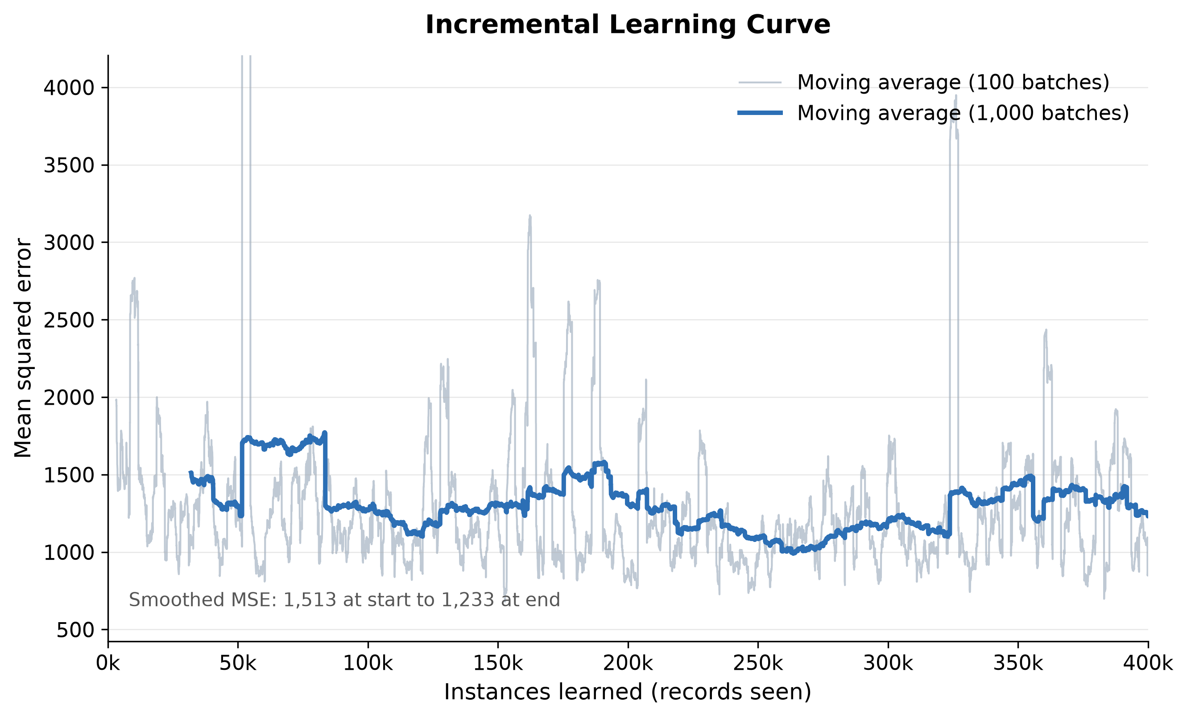
Learning Curve
REQUIRED
Moving-average MSE vs. instances learned
Smoothed MSE falls 1,513 → 1,233 across 400,000 instances. Noise is batch-level variance, not instability.
Notes:
X-axis is instances learned (0 to 400,000), y-axis is the moving average of batch MSE — exactly as the assignment specifies.
We smooth because raw per-batch MSE on 32 records swings between roughly 300 and 5,000 purely from which rows land in the batch. The 1,000-batch moving average shows the trend: 1,513 down to 1,233.
Do NOT quote MSE_first_batch (455) against MSE_last_batch (1,747) — those are two single noisy batches and would wrongly suggest the model got worse. The moving average is the defensible number.
The curve is still declining at the end, which says a second epoch would likely help.

Slide 9
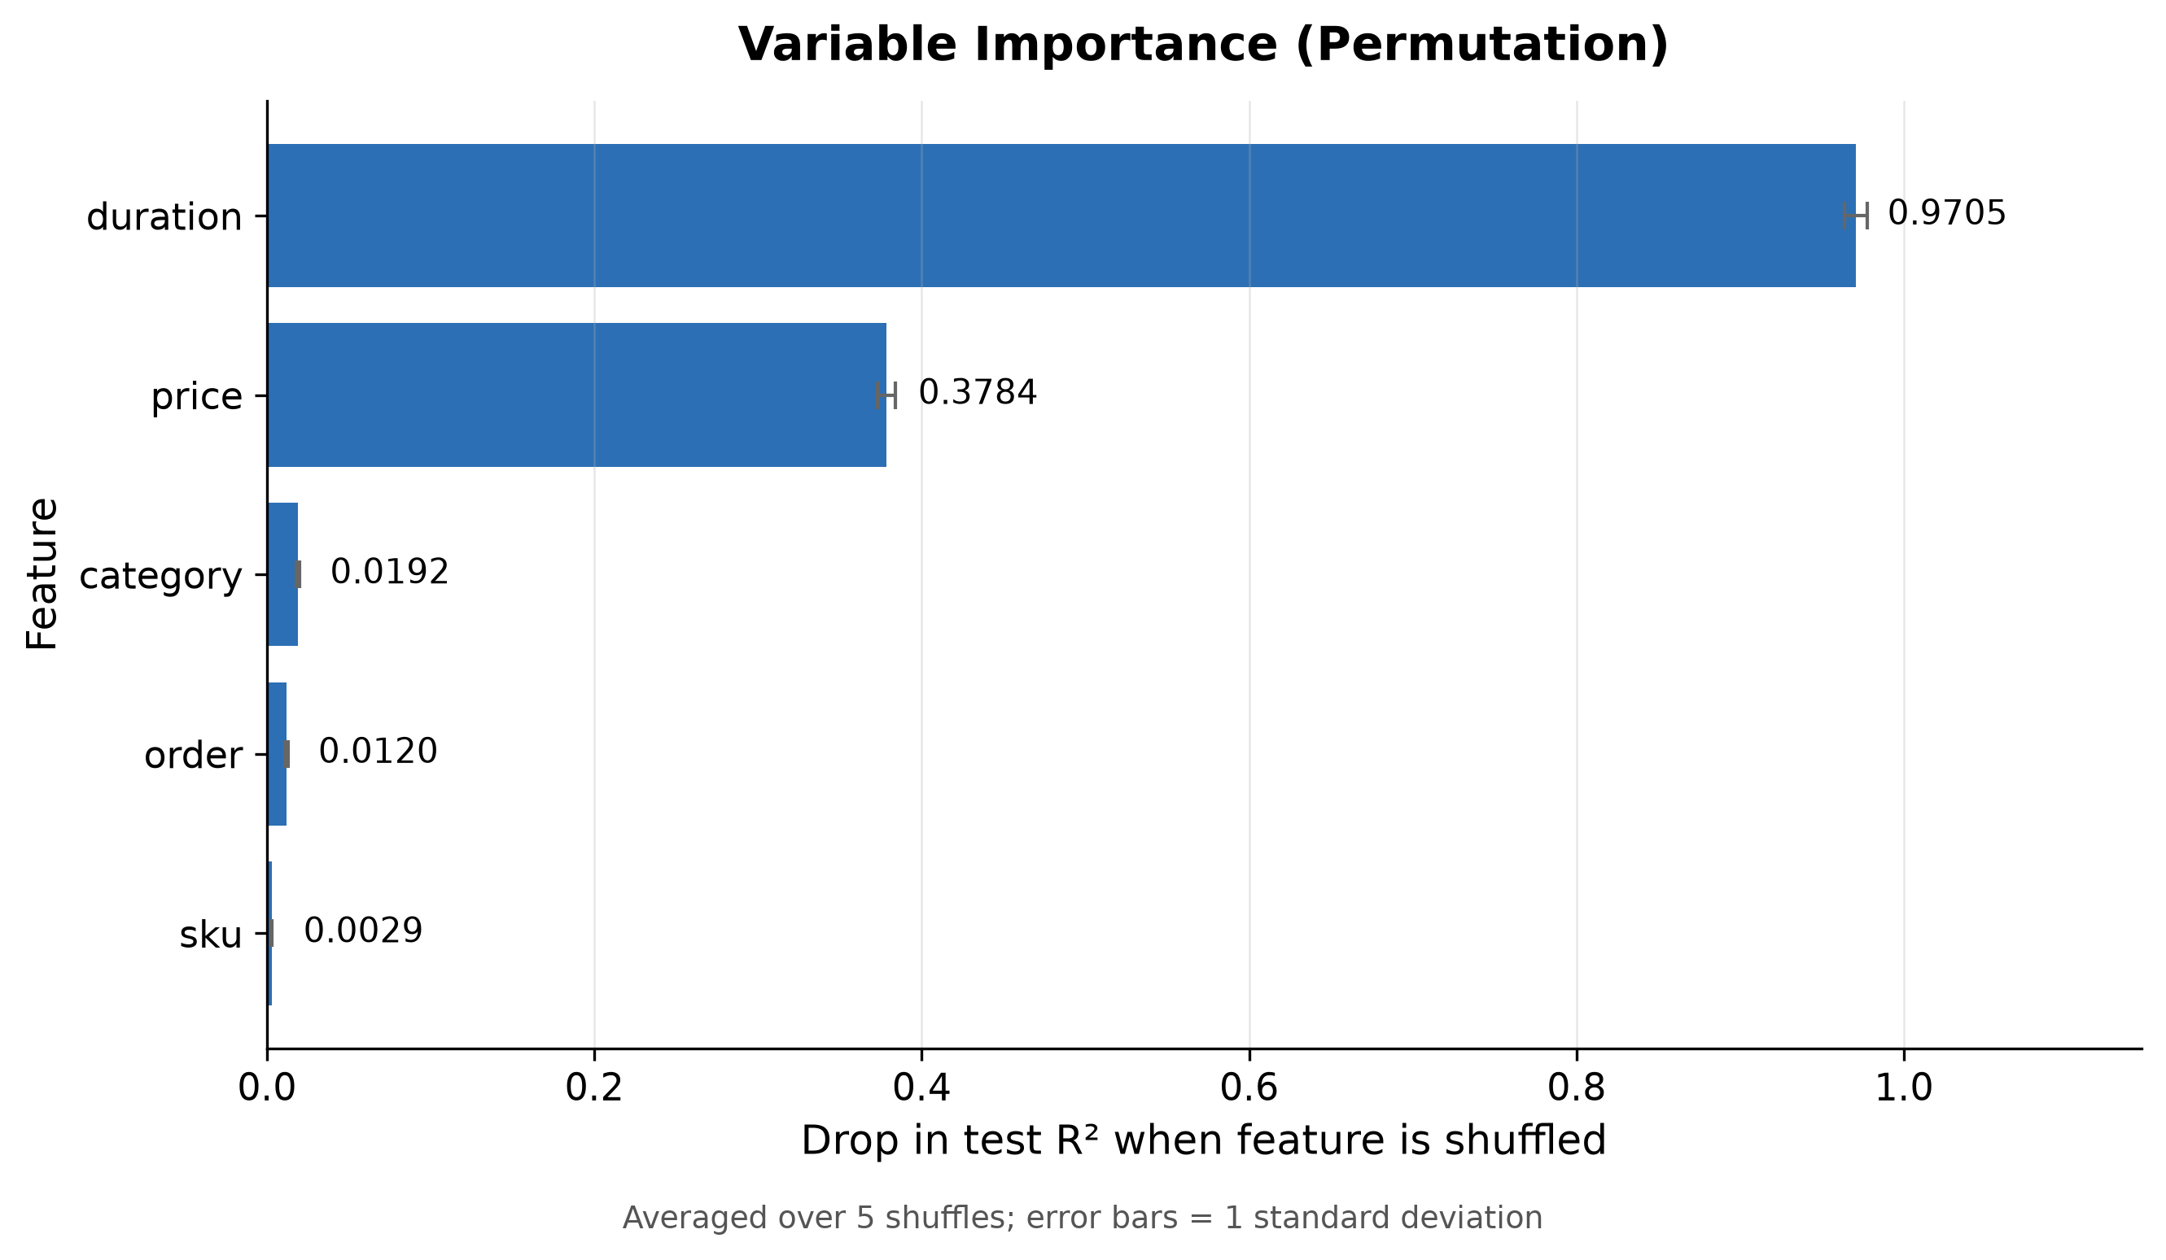
Variable Importance
REQUIRED
Permutation importance — drop in test R² when shuffled
Reading it
duration dominates
0.97 R² drop when shuffled
price is secondary
0.38 R² drop
sku, order, category
near zero — little signal
A drop > current R² means the
model becomes worse than
predicting the mean.
Notes:
Permutation importance: shuffle one column in the test set, re-predict, measure how far R2 falls. Model is never retrained.
duration scores 0.9705. Our test R2 is 0.5356, so destroying duration drops R2 to roughly -0.43 — worse than simply predicting the mean. The model is heavily dependent on it.
That also answers a likely question: importances need not sum to 1 and can exceed the model's R2, because a shuffled column injects actively misleading signal rather than merely removing information.
sku at 0.003 is effectively noise — the network learned almost nothing from the product identifier, which is sensible since it is an arbitrary ID.

Slide 10
Partial Dependence Plots
REQUIRED
Effect of each feature while others are held at their means
What each panel shows
duration
steep rise — dominant
price
◼ PASTE results/plots/partial_dependence_plots.png HERE
(5-panel figure: sku · price · order · duration · category)
sharp fall then flat
order
rises at extreme values
category
gentle wave, ±3 units
sku
flat — no signal
Ranking matches the
importance plot exactly.
Notes:
PDP method: take test rows, sweep one feature across a grid of values, average the model's prediction at each grid point. This isolates that feature's marginal effect.
The five panels confirm the importance ranking independently: duration has by far the widest prediction range, price is second, and sku is flat.
Directions are economically sensible — price slopes DOWN (a demand curve: higher price, fewer units) and duration slopes UP (longer on the site, more units sold). The model learned real structure, not noise.
ACTION: run the team's partial_dependence.py, then paste results/plots/partial_dependence_plots.png into the white box and delete the box.

Slide 11
Reading the PDPs Correctly
Where the curves are trustworthy — and where they are not
Feature | Direction | Trustworthy range | Caution
sku | Flat | full range | Confirms near-zero importance
price | Negative, then flat | z ≈ −0.4 to 3.7 | Drop happens almost entirely early
order | Flat where data exists | z ≈ −0.5 to 4.8 | Late rise sits in a <1% tail
duration | Strong positive | z ≈ −0.8 to 4 | 98% of data sits below z = 4
category | Mild wave | full range | Encoded as numeric, not one-hot
⚠ Extrapolation caveat
✓ What we conclude
price, order and duration are heavily right-skewed.
Plotting their full min–max range means most of
the x-axis holds under 2% of the data — so the
dramatic tail behaviour is model extrapolation.
Duration is the dominant driver and price the
secondary one — both confirmed by importance
and by economic logic. Weak features (sku, order)
could be dropped with little loss.
Notes:
This slide is the one that shows we understood the method rather than just ran it.
Measured on the real test set: the interval containing 98% of the data covers only 10.9% of the plotted x-axis for price, 18.4% for duration, and 34.4% for order. So most of the visible curve lies in regions with almost no training data, where the network is extrapolating.
Concrete example: the duration panel rises to about 560 predicted units at the far right. The 99.9th percentile of actual quantity in the whole dataset is 544. That endpoint is an artifact of extrapolating a sigmoid network far outside the data, not a real prediction.
Same for order: it looks like it climbs steeply, but empirically mean quantity by order decile is roughly flat (correlation 0.04) and its permutation importance is 0.012. The visible rise sits in a tail holding under 1% of records. The flat-where-data-exists reading is the correct one and is consistent with the importance plot.
Fix if asked: restrict the PDP grid to the 1st-99th percentile instead of min-max, and add a rug or histogram of the data density underneath each panel.
Also note PDPs show association under a ceteris-paribus assumption; they do not prove causation and do not capture feature interactions.

Slide 12
RAM Usage
REQUIRED
Measured with psutil at every batch
6.5 MB
423.7 MB
77.4 MB
drift across 12,500 updates
peak during training
growth from start
Stage | RSS memory | Note
Process start | 346.4 MB | Python + TensorFlow
After data load | 383.7 MB | full CSV in memory
After model build | 391.9 MB | 3,009 parameters
End of training loop | 423.7 MB | 12,500 batches later
Memory stayed flat during training — 417.2 → 423.7 MB over 12,500 updates.
Mini-batching means cost scales with BATCH SIZE, not with dataset size.
Notes:
This is the evidence that incremental learning actually works.
The number that matters is 6.5 MB of drift across 12,500 weight updates. Memory is essentially flat during the loop, which proves no accumulation per batch. A memory leak would show a steady climb.
Honest caveat we should state: our peak RSS reaches 553 MB, but that spike happens AFTER training, when model.predict is called on all 400,000 rows at once for evaluation. It is not part of the incremental loop. Training itself peaks at 423.7 MB.
Second honest caveat: data_handler.py currently reads the whole CSV with pd.read_csv, so ingestion is not yet chunked — only training is incremental. At 19 MB that is fine, but for data truly larger than RAM we would swap in pd.read_csv(chunksize=...). The training loop itself needs no change, which is the point.

Slide 13
Training Time
REQUIRED
Single pass over 400,000 records
45.0 s
3.6 ms
8,900
total training
per mini-batch
records / second
Phase | Time
Load and split 500,000 rows | ≈ 2 s
Incremental training — 12,500 batches | 45.0 s
Evaluation and plotting | ≈ 5 s
Total end-to-end | ≈ 52 s
Per-batch overhead dominates: 12,500 separate Python-level calls into TensorFlow.
Notes:
45 seconds for one full pass on CPU.
The cost here is overhead, not arithmetic. 3,009 parameters is tiny; what takes the time is crossing from Python into TensorFlow 12,500 separate times. Larger batches amortize that — we measured batch 256 running roughly 3.5x faster per epoch.
If asked about the tradeoff: larger batches mean fewer weight updates per epoch, so at a fixed single epoch, batch 256 actually scores slightly lower R2 than batch 32. The win only appears when the saved time is spent on more epochs.

Slide 14
Team Contributions
REQUIRED
Group 7
Member | Responsibilities | Deliverables
Ansley | Data exploration · mini-batch loader · incremental training loop · memory tracking · full-dataset run | data_handler.py main.py memory_log.csv
Rebecca | Network architecture · R² and MSE functions · moving average · variable importance · partial dependence analysis | model.py evaluate.py plots + PDP analysis
Ximin | Testing checklist · sample datasets · run log and issue tracking · results organization · presentation | test samples RUN_LOG.md this deck
All three members reviewed the final results and validated the metrics independently.
Notes:
Required element: statement of who did what.
Confirm these descriptions with Ansley and Rebecca before submitting — accuracy matters more than balance here.

Slide 15
What We Learned
Honest limitations and next steps
✓ What worked
→ What we would change
Memory flat across 12,500 updates
Chunk the CSV read (pd.read_csv chunksize)
Test R² 0.5356 beats linear (0.3744)
More epochs — curve still declining
No overfitting — gap of 0.0006
Batch 256 + 10 epochs ≈ +0.02 R²
Clean split, scaler fit on train only
One-hot encode category, not numeric
PDPs match importance ranking
Seed weight init for reproducibility
Every metric logged to disk
Clip PDP grids to 1st–99th percentile
Sigmoid was required here; ReLU would likely train faster, since stacked sigmoids shrink gradients.
Notes:
Closing slide — stating limitations openly reads as understanding, not weakness.
The sigmoid point is worth being able to defend: the sigmoid derivative peaks at 0.25, so stacking three of them attenuates the gradient reaching the first hidden layer by at most 0.25^3, roughly 0.016, and in practice far more. That throttles early-layer learning, which matters a lot when we only get one pass over the data. The assignment required sigmoid, so this is an observation rather than a complaint.
Category is currently fed as an integer 0-32, which implies an ordering that does not exist. One-hot encoding is the correct treatment and is our clearest next improvement.

